Slide 1
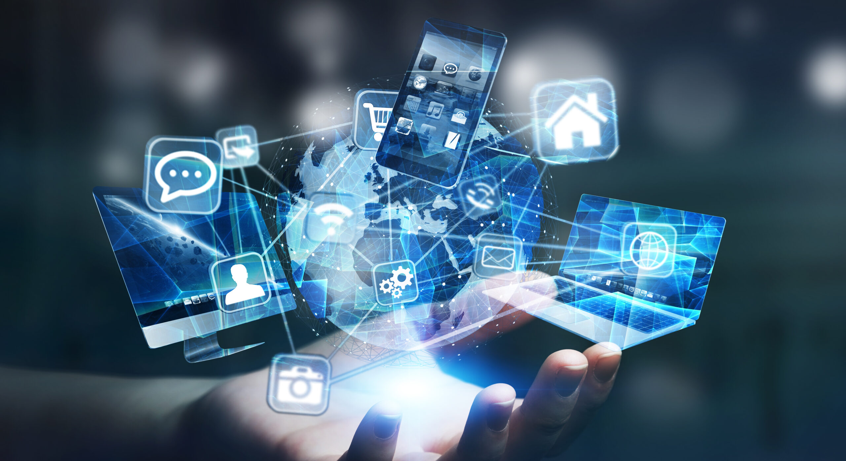
Welcome To
Presentation

Slide 2
Group Ten Questions
A. Discuss the main social and cultural impacts of iot?
B. Identify the main challenges of an iot and suggest possible solutions
C. Discuss the role the network play in the iot of everything?
D. Discuss how wireless communication might affect the development And implementations of iot?

Slide 3
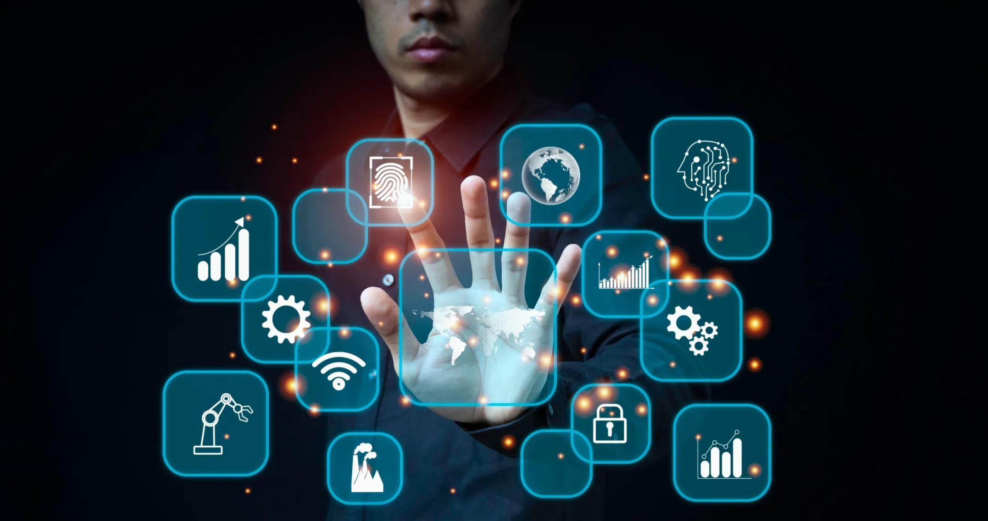
IoT's Social and Cultural Impact
Revolutionizing Interactions
IoT promotes remote communication, changing how we connect with others.
Cultural norms are evolving as IoT blurs boundaries between physical and digital.
Privacy concerns arise as IoT collects and shares personal data without consent.
IoT influences art, fashion, and entertainment, shaping new cultural trends.
Photo by Scarzewan

Slide 4
Challenges of IoT
Benefits of IoT
Challenges of IoT
Enhanced connectivity leads to improved efficiency in operations.
Real-time insights enable better decision-making for businesses.
IoT can provide valuable data for predictive maintenance of equipment.
Security vulnerabilities pose a significant risk to IoT devices and networks.
Privacy concerns arise due to the vast amount of personal data collected.
Scalability issues can hinder the widespread adoption and deployment of IoT solutions.

Slide 5
Solutions to IoT Challenges
Positive Solutions
Challenges to Consider
Encryption helps protect data from unauthorized access and ensures confidentiality.
Data governance policies aid in maintaining data integrity and compliance with regulations.
Device authentication ensures only authorized devices can access the IoT network.
Implementing encryption can sometimes lead to increased processing overhead and potentially slower performance.
Developing and enforcing data governance policies can be complex and time-consuming.
Device authentication methods may need to be continually updated to keep pace with evolving security threats.

Slide 6
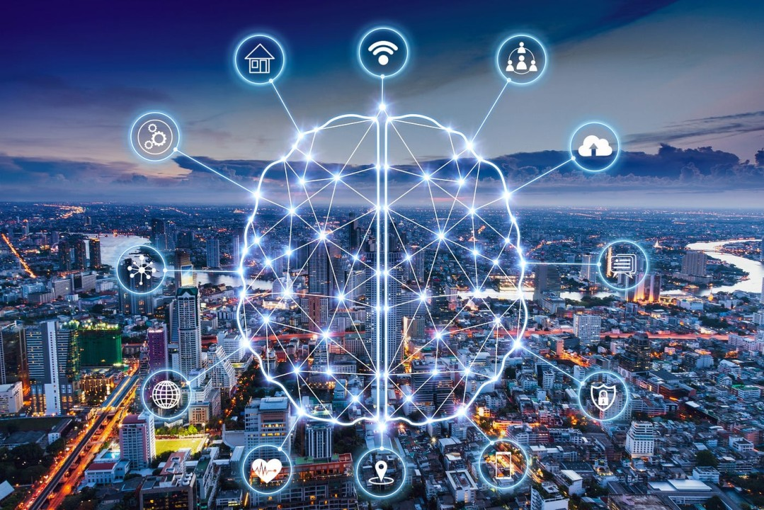
Networks in IoT
Key Role
Networks enable seamless communication
Critical for data transfer efficiency
Interconnected devices rely on networks
Examples include WiFi, Bluetooth, and cellular
Photo by Scarzewan

Slide 7
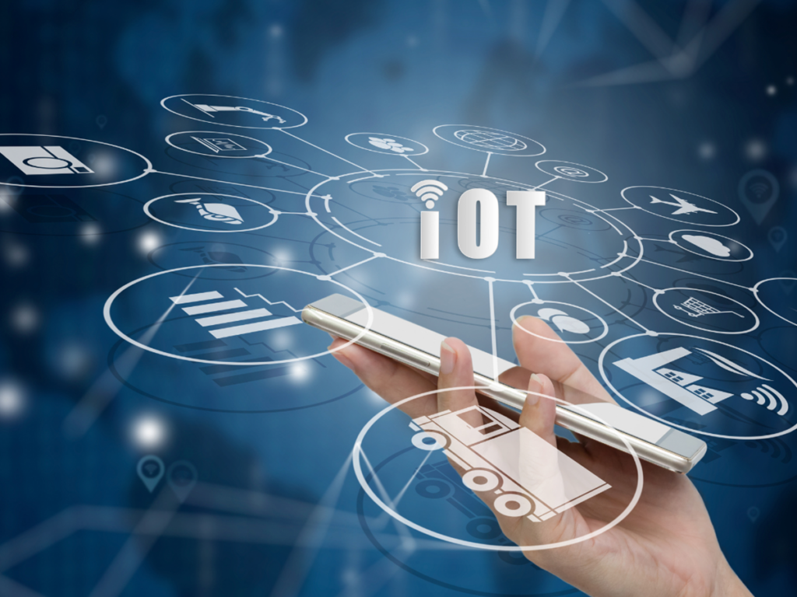
Wireless Tech and IoT
Tech for IoT Growth
Wireless protocols like WiFi and Bluetooth enable seamless IoT connectivity.
5G networks provide high-speed, low-latency communication for IoT devices.
IoT applications in smart homes, healthcare, and agriculture benefit from wireless technology.
Wireless communication plays a crucial role in expanding the IoT ecosystem.
Photo by Scarzewan

Slide 8
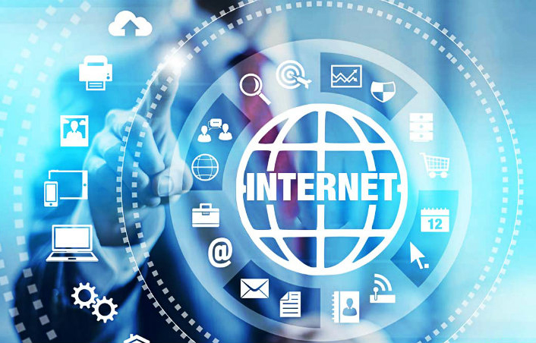
Wireless Connectivity Impact
Wireless communication enables seamless IoT connectivity enhancing accessibility.
Flexibility of wireless networks allows adaptive IoT solutions for diverse environments.
Real-time data transmission over wireless promotes instant IoT device responses.
Wireless connectivity empowers IoT applications in remote locations and mobile devices.
Photo by Scarzewan

Slide 9
Evolution of IoT Technology
Early Years
Introduction of RFID & sensor networks. First IoT devices used for monitoring and data collection.
Expansion Phase
Growth in connected devices. Introduction of IoT platforms and cloud services for data management.
Current Trends
Integration of AI and machine learning. Focus on security, privacy, and interoperability in IoT systems.

Slide 10
Benefits of IoT
Advantages of IoT
Challenges of IoT
IoT improves efficiency by automating processes and reducing manual labor.
IoT enhances productivity by providing real-time data and insights for decision-making.
IoT offers convenience through remote monitoring and control of devices and systems.
IoT security concerns such as data privacy and potential hacking risks.
IoT implementation costs can be high initially for devices, infrastructure, and software.
IoT compatibility issues may arise when integrating different devices from various manufacturers.

Slide 11
Group 10 Members
1. Abdulai muntari wadud UG0808223
2. Saeed abdul hafiz angaamwine UG0825723
3. Mensah opoku Alfred UG0837123
4. Iddrisu suguru saibu UG0865523
5. Abubakari osman UG0835123
6. Nuobatolo Gaeten UG0789723
7. Aweisu Abdul Rashad UG0843323

Slide 12
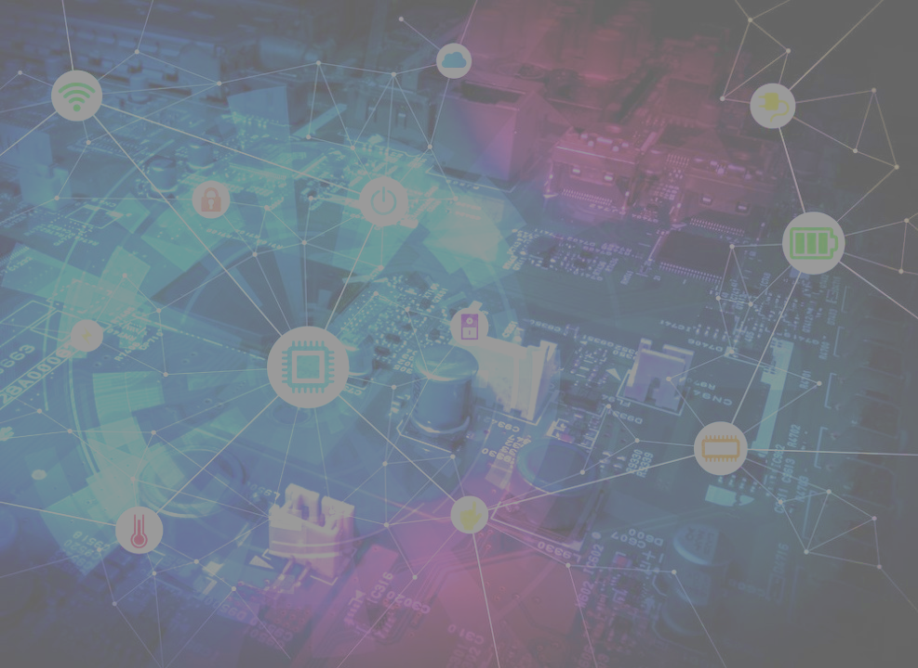
End Of
Presentation

